Slide 1
Determining asteroid diameters from occultations
Dave Herald

Slide 2
In our predictions, we rely on asteroid diameters determined from (in order):
AKARI AcuA (IR satellite measurements)
IRAS diamalb (IR satellite measurements)
WISE MBA (IR satellite measurements)
Asteroid absolute magnitude H0, using a nominal albedo: Dia = 10 ^{(3.52 - H0/5)}

Slide 3
Recently the New York Times published an article that asserted the NASA scientists responsible for analysing the WISE & NEOWISE data had not analysed the data correctly
Argument was based on theoretical considerations of the mathematics/statistics used
Assertions were made that WISE & NEOWISE diameters could be in error by a large amount
Underlying problem – how do we check the validity of inferred diameters

Slide 4
Current techniques for measuring asteroid diameters are:
Direct measure from a visiting satellite (not many!)
Radar imaging (not many, and they are mainly of Near-Earth asteroids)
Direct imaging with adaptive optics (not many)
Occultations

Slide 5
Problem with occultations
Asteroids are irregular in shape
An asteroidal occultation can derive a profile for a particular orientation of an asteroid, at the 1km level
Problem
how do you derive the mean diameter of an asteroid from a single observed profile?
how do you reliably combine results from different events in a determinative manner?

Slide 6
Meaning of Mean diameter
What is the ‘mean’ diameter of an irregular object? In practice, the possibilities are:
diameter of a sphere that has the same volume as the object
diameter of a sphere that has the same surface area as the object
tri-axial ellipsoid that has the same volume and moment of inertia as the object (although this does not have a single diameter)

Slide 7
Diameters of spheres of equal volume and equal surface area are generally different
Example: the ‘mean diameter’ of a cube based on equivalence of surface area is 11% larger than that based on volume.
The most logical basis is volume equivalence. (From advice) WISE determinations apparently are based on surface equivalence. (Other satellite measurements may also be on surface area). Ellipsoidal determinations do not have a single diameter
At the level of precision we can achieve, it is critical that we specify the basis of any ‘mean diameter’ determination.

Slide 8
Using shape models
Can solve the occultation profile issue by fitting observations to shape models
DAMIT shape models now include (in metadata) the dimension of the mean diameter – based on both volume and surface area – with each shape model
In principle, by fitting the chords from a single occultation event to a shape model, we can directly measure the asteroid’s mean diameter

Slide 9
Practical problem #1
Shape models are derived from light curves measured over a period of years
The period of rotation has a level of uncertainty that is not readily available. That uncertainty depends upon:
The length of time covered by the light curves
The elapsed time since the end of the light curve coverage.
The uncertainty at the date of an occultation can vary between a small fraction of a rotation, to multiple rotations of the asteroid.
In general, the asteroid shape model plotted at the time of an event will be incorrectly oriented because of the uncertainty in the rotation period

Slide 10
Practical problem #2
The light-curve inversion process for determining a shape model almost always has multiple solutions
The multiple solutions arise from different orientations of the axis of rotation

Slide 11
Challenge
to reliably determine the mean diameter using occultation observations, we need to use shape models
However we need to identify which shape model is the ‘correct’ model, and derive a period of rotation that gives the correct orientation for plural occultation events
Once this is done, we can determine the mean diameter by fitting occultation results to the shape model. By doing this for multiple events, we can get a statistical measure of the accuracy.

Slide 12
Occult tool
Occult now has a tool under development to facilitate determination
Allows download of multiple orientations of a shape model at different intervals – to find the best fit, and identify the correct model
Also allows the download of information on the basis of the light curve

Slide 13
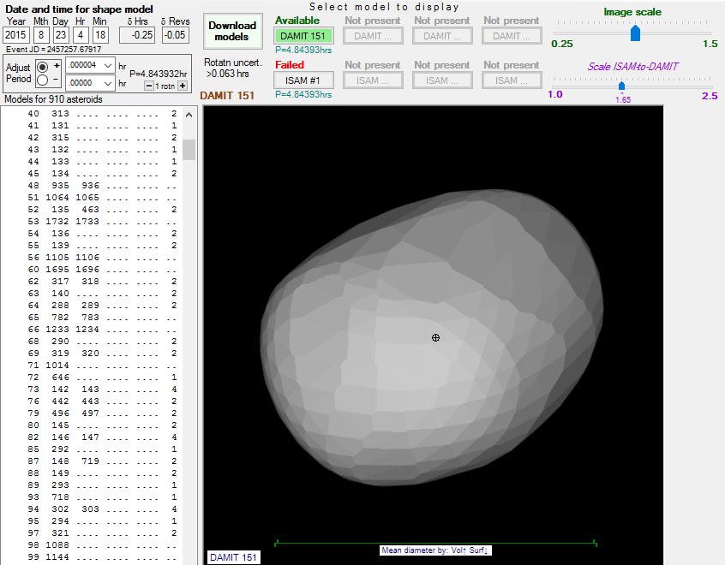

Slide 14
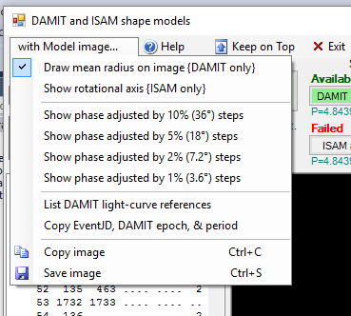
Options for shape model downloads

Slide 15
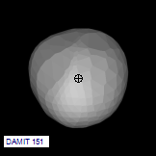
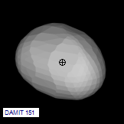
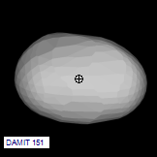
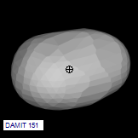
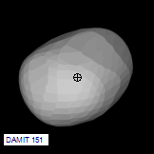
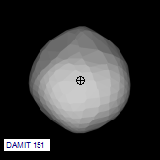
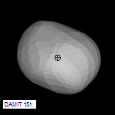
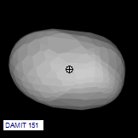
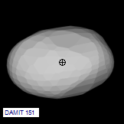
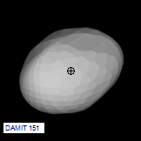
10 models for best fitting

Slide 16
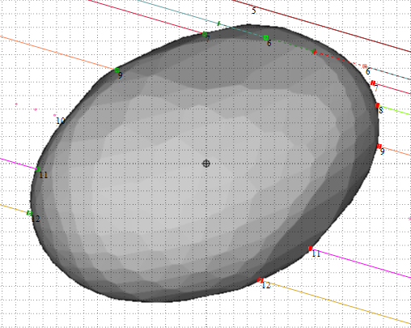
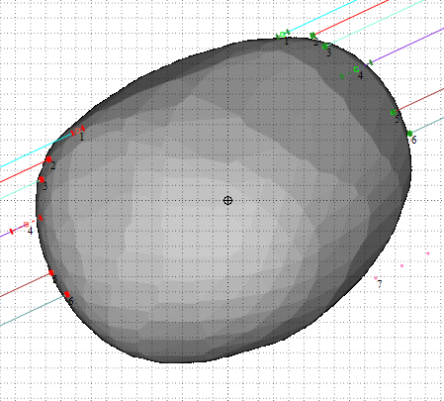
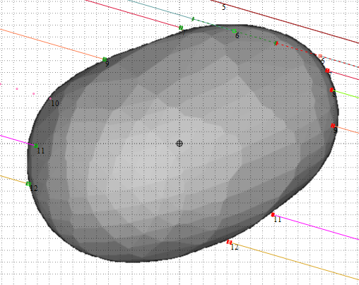
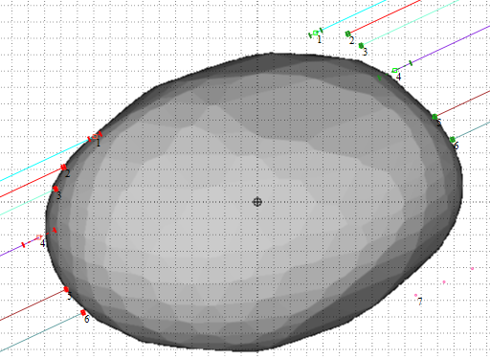
Example (107) Camilla
2016 Jul 21
2015 Aug 23
Option 1:
Period increased by 0.000004hrs
Option 2:
Period decreased by
0.000030hrs

Slide 17
Camilla - diameter from occultations
Event | Mean dia - volume | Mean dia -surface | Comments
2015 Jul 21 | 221 km | 225 km
2015 Aug 23 | 227 km | 231 km
2015 May 6 |  |  | Northern-most chord appears to be unreliable. Middle chord has large uncertainty. No reliable determination possible.
2015 Feb 12 |  |  | Double star. Insufficient data to resolve reliably
2015 Jan 1 |  |  | 1 chord with a nearby miss. No determination possible
2014 Mar 13 |  |  | 3 chords of inconsistent length close together. No reliable determination possible
2013 May 7 |  |  | Severe timing problems with northernmost chord. Other chord ‘possible’, not definite. No determination possible
2011 Oct 23 | >218 km | >222 km | Single chord
2004 Sep 5 | 214 km | 218 km | Observed chords do not fit shape model. Middle chord affected by cirrus. Diameter derived by assuming the chord durations are correct for the two chords not affected by cloud. Result must be doubtful.

Slide 18
Diameter result
Allocating a reduced weight to the 2004 Sep 5 observation, the Mean Diameter of (107) Camilla is :
223 ± 4 km (equivalent volume); or
227 ± 4 km (equivalent surface area).
This compares with:
IRAS 222.62km (±17.1 km)
AcuA 200.37km (±3.51 km)
Wise 219.37km (±5.94 km + 10% systematic uncertainty)

Slide 19
Learning #1
Accurate time base is essential
Need to consider the possibility of a shape model fit at two or more different orientations
Need at least two well-observed events to resolve model, and period correction
Need to consider the possibility of the rotation being in error by more than one full rotation

Slide 20
Learning #2
The correct model and period should fit all past observations
Where a fit does not occur, need to look carefully at the individual observations
Shape model fitting – if done correctly – will identify/exclude erroneous chords

Slide 21
Accurate measurement of asteroid size from occultations is now possible….
Any questions?!

